Slide 1
From clouds to cores to envelopes to disks a multi-scale view of magnetized star formation
Chat Hull
University of California, Berkeley
Radio Astronomy Laboratory
6 November 2013
NRAO lunch talk
Socorro, N.M.
Notes:
Star formation regions

Slide 2
Outline
Magnetized star formation
B-fields vs. outflows: multi-scale comparisons
Outflows/jets/disks and B-fields are randomly aligned (or perhaps ⟂?)
TADPOL survey
CARMA 1mm full-Stokes polarization system
B-fields: multi-scale comparisons
Cloud → core → envelope → disk
Two populations of cores: high and low polarization fraction
Back to outflows!
Disk formation implications
VLA proposal
Filaments in the Perseus cluster (NGC 1275)

Slide 3
Scales of star formation
> 1 pc
0.1 pc
1000 AU
< 100 AU
cloud
core
envelope
disk

Slide 4
Outline
Magnetized star formation
B-fields vs. outflows: multi-scale comparisons
Outflows/jets/disks and B-fields are randomly aligned (or perhaps ⟂?)
TADPOL survey
CARMA 1mm full-Stokes polarization system
B-fields: multi-scale comparisons
Cloud → core → envelope → disk
Two populations of cores: high and low polarization fraction
Back to outflows!
Disk formation implications
VLA proposal
Filaments in the Perseus cluster (NGC 1275)

Slide 5
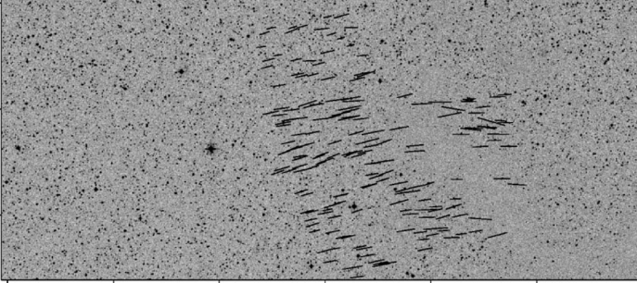
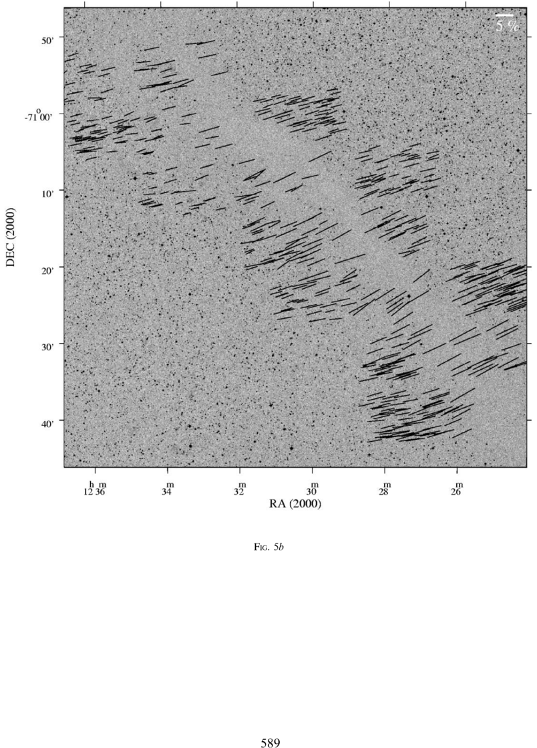
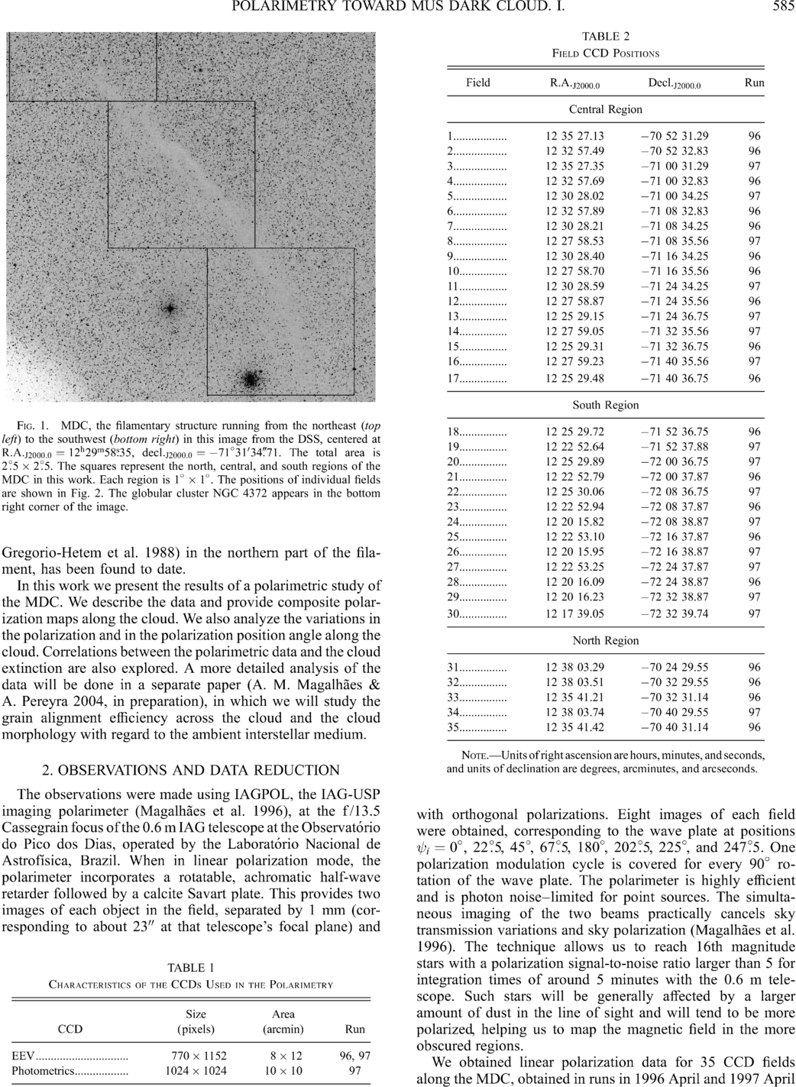
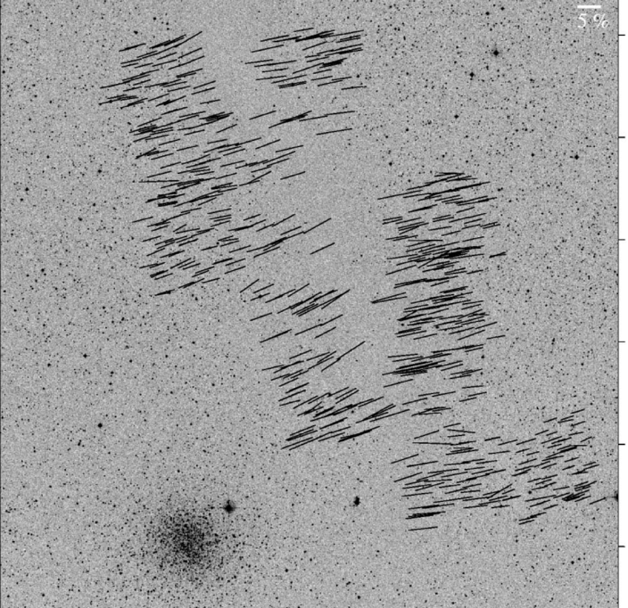
Large-scale: ordered fields
Musca dark cloud
10 pc
E,B
Pereyra & Magalhães 2004
Notes:
-Distance: 250 pc
-Mass: 250 solar masses
-Length ~10 pc

Slide 6
Dust grain alignment
ALIGNED DUST GRAINS
ORDERED MAGNETIC FIELD
Notes:
-Extremely high percentage polarization, thus…
-High-SNR correlation between LCP and RCP.
-Band dependent due to hardware
-Antenna dependent
-Forward gains of antennas: 100 Jy/K (10m), 150 Jy/K (6m)
-Sky temperature calculation: atmosphere temp*(1 – \e^{-\tau}), or (280 K)*(1 – e^(-0.2)) = ~50 K for typical weather

Slide 7

Polarization (dust absorption)
ALIGNED DUST GRAINS
BACKGROUND STAR
(unpolarized)
ORDERED MAGNETIC FIELD
Notes:
-Extremely high percentage polarization, thus…
-High-SNR correlation between LCP and RCP.
-Band dependent due to hardware
-Antenna dependent
-Forward gains of antennas: 100 Jy/K (10m), 150 Jy/K (6m)
-Sky temperature calculation: atmosphere temp*(1 – \e^{-\tau}), or (280 K)*(1 – e^(-0.2)) = ~50 K for typical weather

Slide 8


What is the role of magnetic fields in star formation?
Incidental?
Fundamental?

Slide 9
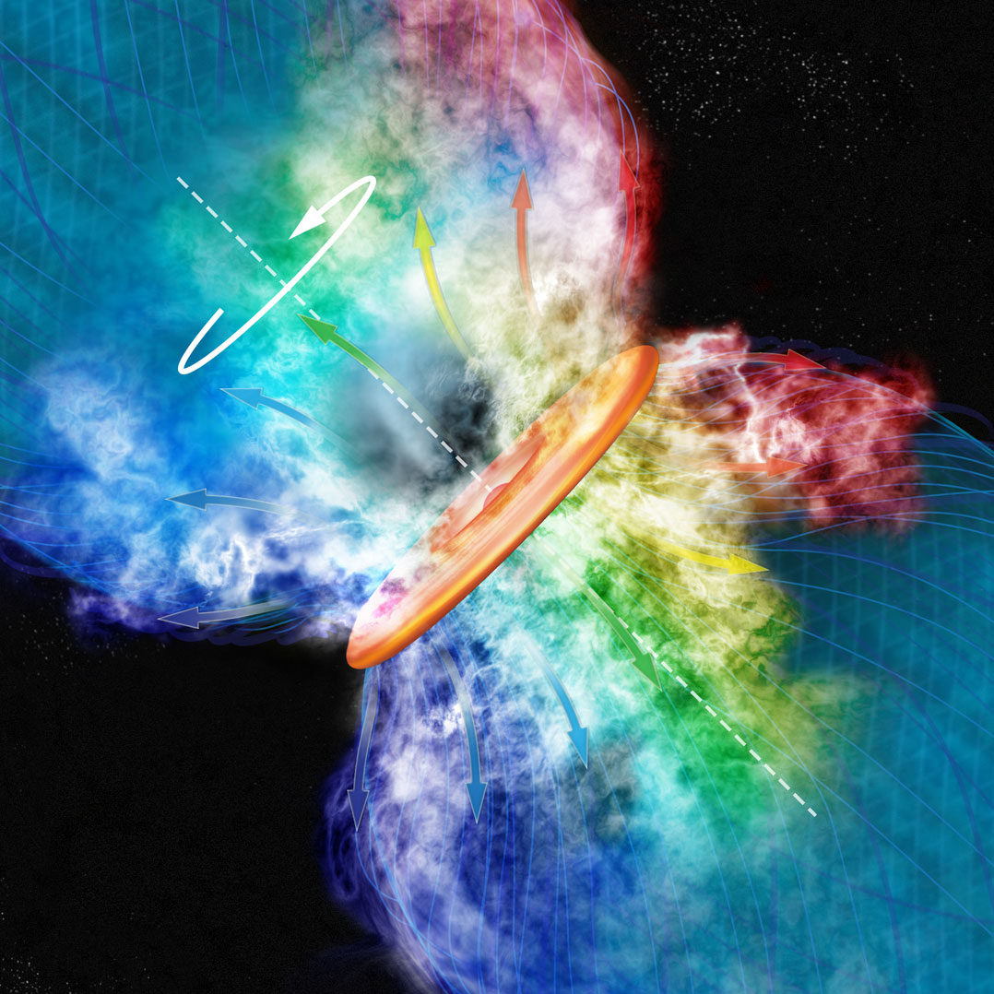
Credit: Bill Saxton, NRAO/AUI
KALYPSO project, Harvard/CfA

Slide 10
Outline
Magnetized star formation
B-fields vs. outflows: multi-scale comparisons
Outflows/jets/disks and B-fields are randomly aligned (or perhaps ⟂?)
TADPOL survey
CARMA 1mm full-Stokes polarization system
B-fields: multi-scale comparisons
Cloud → core → envelope → disk
Two populations of cores: high and low polarization fraction
Back to outflows!
Disk formation implications
VLA proposal
Filaments in the Perseus cluster (NGC 1275)

Slide 11
Multi-scale comparisons: B-fields vs. outflows
1 pc
0.1 pc
1000 AU
100 AU
RANDOM
Ménard & Duchêne 2004
Targon+ 2011

Slide 12
Misalignment of B-fields and disks/jets
Comparing orientations of large-scale B-field with disks/jets in T Tauri stars
1
Ménard & Duchêne 2004
Cumulative Distribution Function (CDF)
0
0º
90º
𝜽_{disk/jet} – 𝜽_{B-field} (deg)
10 pc

Slide 13
Misalignment of B-fields and disks/jets
1
CDF
~1 pc
Targon+ 2011
0
0º
𝜽_{jet} – 𝜽_{B-field} (deg)
90º

Slide 14
Multi-scale comparisons: B-fields vs. outflows
1 pc
0.1 pc
1000 AU
100 AU
RANDOM
Ménard & Duchêne 2004
Targon+ 2011

Slide 15
Multi-scale comparisons: B-fields vs. outflows
1 pc
0.1 pc
1000 AU
100 AU
RANDOM
Curran & Chrysostomou 2007

Slide 16
Polarization (dust absorption)
ALIGNED DUST GRAINS
BACKGROUND STAR
(unpolarized)
ORDERED MAGNETIC FIELD
Notes:
-Extremely high percentage polarization, thus…
-High-SNR correlation between LCP and RCP.
-Band dependent due to hardware
-Antenna dependent
-Forward gains of antennas: 100 Jy/K (10m), 150 Jy/K (6m)
-Sky temperature calculation: atmosphere temp*(1 – \e^{-\tau}), or (280 K)*(1 – e^(-0.2)) = ~50 K for typical weather

Slide 17
Polarization (dust EMISSION)
ALIGNED DUST GRAINS
ORDERED MAGNETIC FIELD
Notes:
-Extremely high percentage polarization, thus…
-High-SNR correlation between LCP and RCP.
-Band dependent due to hardware
-Antenna dependent
-Forward gains of antennas: 100 Jy/K (10m), 150 Jy/K (6m)
-Sky temperature calculation: atmosphere temp*(1 – \e^{-\tau}), or (280 K)*(1 – e^(-0.2)) = ~50 K for typical weather

Slide 18
Misalignment of B-fields and outflows
Comparing B-fields with outflows on the core (~0.1 pc) scale
B
CDF
~0.25 pc
Curran & Chrysostomou 2007
𝜽_{outflow} – 𝜽_{B-field} (deg)

Slide 19
Multi-scale comparisons: B-fields vs. outflows
1 pc
0.1 pc
1000 AU
100 AU
RANDOM
Curran & Chrysostomou 2007

Slide 20
Multi-scale comparisons: B-fields vs. outflows
1 pc
0.1 pc
1000 AU
100 AU
RANDOM
Or preferentially ⟂ ?
Hull+ 2013a

Slide 21
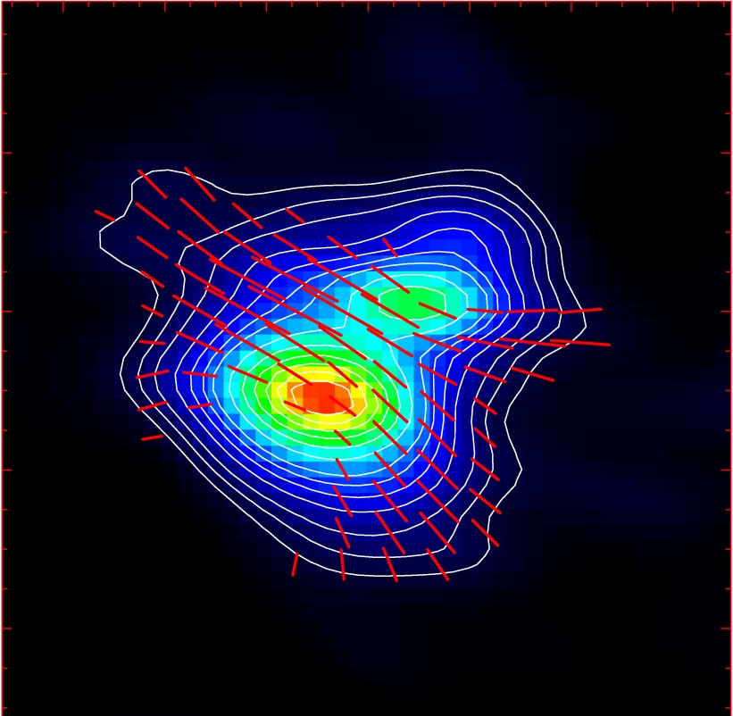
Misalignment of B-fields and outflows
IRAS 16293
NGC 1333-IRAS 4A
B-field
Rao+ 2009
Girart+ 2006
Outflow
Notes:
ROTATION: IRAS 16293 has rot/grav < 0.1; IRAS4A seems the same (barely any rotation); VLA 1623 questionable (probably slow)
-Holland: JCMT data
-Rao, Girart: SMA
-This is okay, according to Hennebelle & Ciardi ‘09 (easier to form disks with obliquity!)
-Ward-Thompson et al (2009) saw a 30 deg offset between short axes of cores and their polarization directions…another problem!

Slide 22
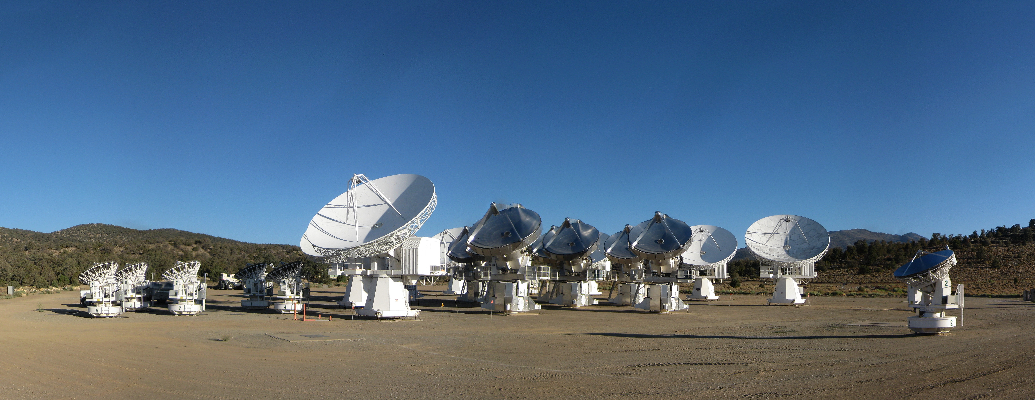
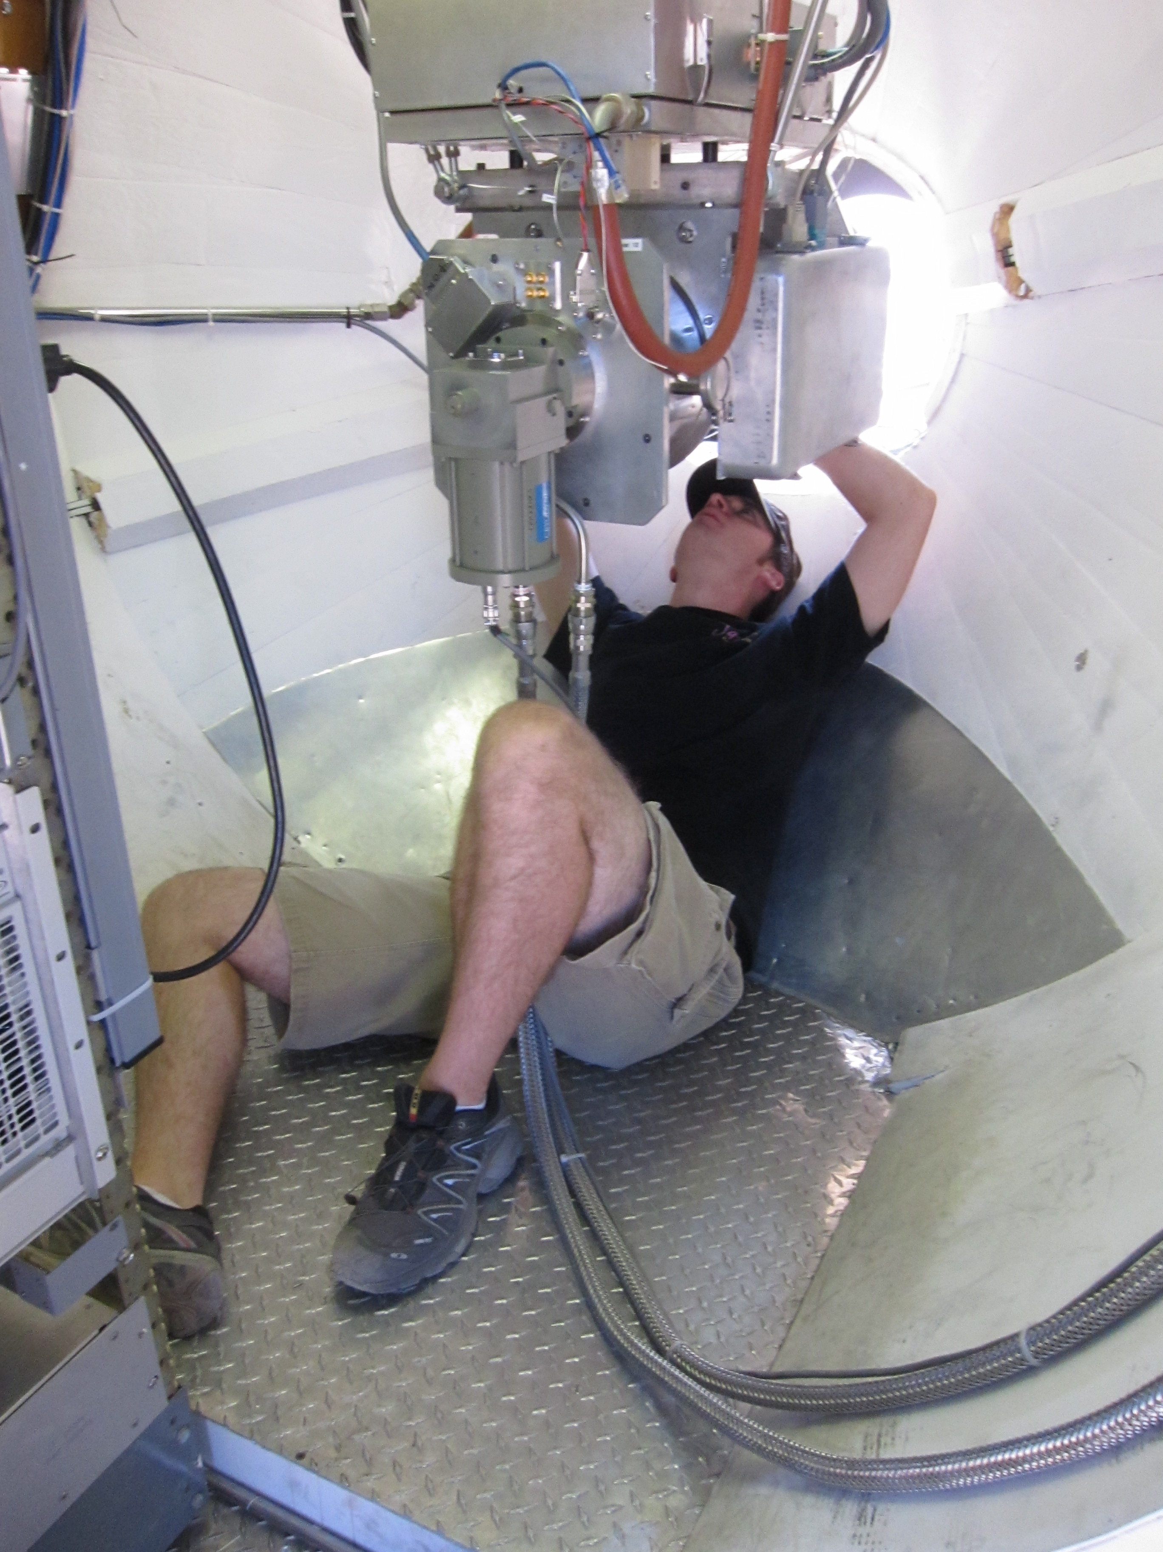
CARMA Combined Array for Research in Millimeter-wave Astronomy Consortium: Berkeley, Caltech, Illinois, Maryland, Chicago
6 ⨯10-m, 9 ⨯ 6-m, and 8 ⨯ 3.5-m telescopes
Observations at 1 cm, 3 mm, and
1 mm (polarization!)
Located in Cedar Flat, CA (near Bishop)
Notes:
SMA: 8*6m antennas = 226 m^2
CARMA: 6*10m, 9*6m = 726 m^2 (more than factor of 3 more area)
-Factor of two more dishes
-Equivalent T_sys?

Slide 23
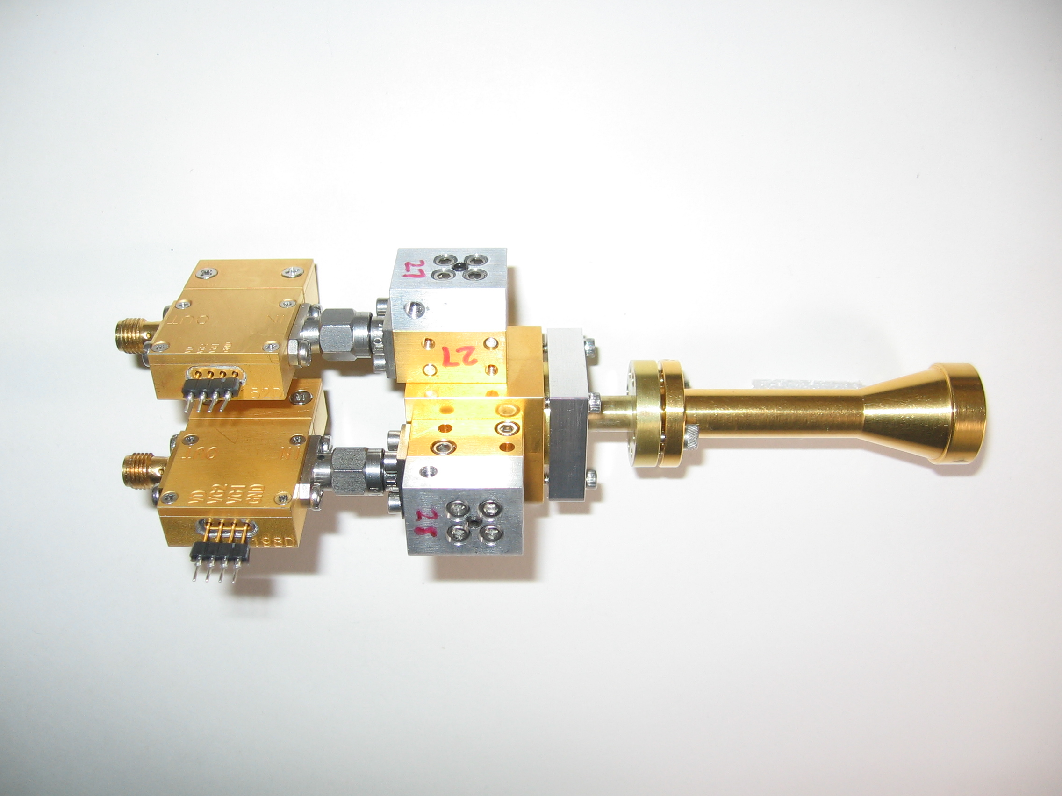
1 mm dual-polarization receivers
SIS mixers
Orthomode transducer
Waveguide circular polarizer
1 inch
WBA13
I.F. amplifiers (1-9 GHz)
Credit: Dick Plambeck
Notes:
-Sensitive to RCP & LCP
-Null experiment: in the absence of linear polarization, you get no RL correlation at any time.
-If you have linear feeds, you have XY correlation sometimes (when the intrinsic polarization is at 45º to your two feeds), and not other times (when it’s along one feed or the other). Thus, to tease out the polarization, you need stable gains

Slide 24
Misalignment of B-fields and outflows
IRAS 16293
NGC 1333-IRAS 4A
B-field
Rao+ 2009
Girart+ 2006
Outflow
Notes:
ROTATION: IRAS 16293 has rot/grav < 0.1; IRAS4A seems the same (barely any rotation); VLA 1623 questionable (probably slow)
-Holland: JCMT data
-Rao, Girart: SMA
-This is okay, according to Hennebelle & Ciardi ‘09 (easier to form disks with obliquity!)
-Ward-Thompson et al (2009) saw a 30 deg offset between short axes of cores and their polarization directions…another problem!

Slide 25
TADPOL survey

Slide 26















TADPOL collaboration
UC Berkeley
Chat Hull (PI), Dick Plambeck, Mel Wright, Carl Heiles, Geoff Bower
University of Maryland
Marc Pound, Alberto Bolatto, Katherine Jameson,
Lee Mundy
Caltech
Thushara Pillai, John Carpenter, James Lamb,
Nikolaus Volgenau
University of Illinois, Urbana-Champagne
Leslie Looney, Dick Crutcher, Nick Hakobian
Other
Dan Marrone (Arizona), Meredith Hughes (Wesleyan), John Vaillancourt & Göran Sandell (USRA-SOFIA), John Tobin (NRAO), Ian Stephens (BU), Jason Fiege & Erica Franzmann (Manitoba), Martin Houde (UWO, Caltech), Brenda Matthews (NRC-CNRC), Woojin Kwon (SRON)

Slide 27
TADPOL survey
37 sources
Largest survey of star-forming cores to date
>500 observing hours
CARMA C, D, & E arrays
1 – 4" resolution
10⨉ higher resolution than CSO & JCMT
Probes intermediate region between ~0.1 pc (single-dish)
and ~100 AU (ALMA)

Slide 28
TADPOL results
L1157
2″
See also: Stephens+ 2013, ApJL, 769, L15
Notes:
NEARBY SF regions:
-Perseus (NGC 1333, L1448, SVS13): 235 pc (masers in SVS13) → 03:30 LST
-Taurus (DG Tau, L1527): 140 pc → 04:30 LST
-Orion: 400 pc → 05:30 LST
-Serpens: 415 pc → 18:30 LST
-Ophiuchus: 140 pc → 17:00 LST
-Cepheus (L1157): 250 pc → 22:00 LST
-Isolated (B335, Bok globule): 250 pc

Slide 29
Credit: Bill Saxton, NRAO/AUI
KALYPSO project, Harvard/CfA

Slide 30
TADPOL results
NGC 1333-IRAS 4A
NGC 1333-IRAS 2A
NGC 1333-IRAS 4B, 4B2
2″
3″
2″
Notes:
NEARBY SF regions:
-Perseus (NGC 1333, L1448, SVS13): 235 pc (masers in SVS13) → 03:30 LST
-Taurus (DG Tau, L1527): 140 pc → 04:30 LST
-Orion: 400 pc → 05:30 LST
-Serpens: 415 pc → 18:30 LST
-Ophiuchus: 140 pc → 17:00 LST
-Cepheus (L1157): 250 pc → 22:00 LST
-Isolated (B335, Bok globule): 250 pc

Slide 31
TADPOL results
L1527
VLA 1623
See also: Tobin+ 2012, Nature, 493, 83
See also: Murillo+ 2013 (arxiv:1310.8481)
2″
3″
Notes:
NEARBY SF regions:
-Perseus (NGC 1333, L1448, SVS13): 235 pc (masers in SVS13) → 03:30 LST
-Taurus (DG Tau, L1527): 140 pc → 04:30 LST
-Orion: 400 pc → 05:30 LST
-Serpens: 415 pc → 18:30 LST
-Ophiuchus: 140 pc → 17:00 LST
-Cepheus (L1157): 250 pc → 22:00 LST
-Isolated (B335, Bok globule): 250 pc

Slide 32
TADPOL results
Ser-emb 8, 8(N)
3″
Notes:
NEARBY SF regions:
-Perseus (NGC 1333, L1448, SVS13): 235 pc (masers in SVS13) → 03:30 LST
-Taurus (DG Tau, L1527): 140 pc → 04:30 LST
-Orion: 400 pc → 05:30 LST
-Serpens: 415 pc → 18:30 LST
-Ophiuchus: 140 pc → 17:00 LST
-Cepheus (L1157): 250 pc → 22:00 LST
-Isolated (B335, Bok globule): 250 pc

Slide 33
Outflow vs. B-field: distribution
Simulation: outflows & B-fields aligned within a 20º cone (tightly aligned)
1
0 – 20º
Simulation: outflows & B-fields are randomly oriented
CDF
Simulation: outflows & B-fields aligned between 70–90º (preferentially misaligned)
Random
70 – 90º
KS-test results:
20º cone ruled out ( p-value ~ 10⁻¹⁵ )
Misaligned ( 0.33 ) and random ( 0.33 ) cannot be ruled out
Hull+ 2013a, ApJ, 768, 159
(plot updated Aug ‘13)
0
0º
90º
𝜽_{outflow} – 𝜽_{B-field} (deg)

Slide 34
Outline
Magnetized star formation
B-fields vs. outflows: multi-scale comparisons
Outflows/jets/disks and B-fields are randomly aligned (or perhaps ⟂?)
TADPOL survey
CARMA 1mm full-Stokes polarization system
B-fields: multi-scale comparisons
Cloud → core → envelope → disk
Two populations of cores: high and low polarization fraction
Back to outflows!
Disk formation implications
VLA proposal
Filaments in the Perseus cluster (NGC 1275)

Slide 35
Multi-scale comparisons: B-fields
> 1 pc
0.1 pc
1000 AU
100 AU
CONSISTENT
Hua-bai Li+ 2009

Slide 36
100 pc → 0.1 pc Consistent B-field in clouds & cores
E,B
~0.3 pc
E
B
H.-b. Li+ 2009
Sub-mm CSO data
n ~ 10⁵ cm⁻³
L ~ 0.3 pc
Optical data
n ~ 1 cm⁻³
L ~ 100 pc
Notes:
Orion Molecular Cloud region
-Optical polarimetry data: blue vectors
-Huge grey vectors: average of all blue vectors
-IRAS data: just to guide the eye (background image)
-CSO data: dust emission
-White vectors: average of CSO dust polarization
-ALL orientations are B-field directions
-Comparing with simulations, they find that a super-Alfvénic cloud (more turbulence than magnetic support) doesn’t fit well

Slide 37
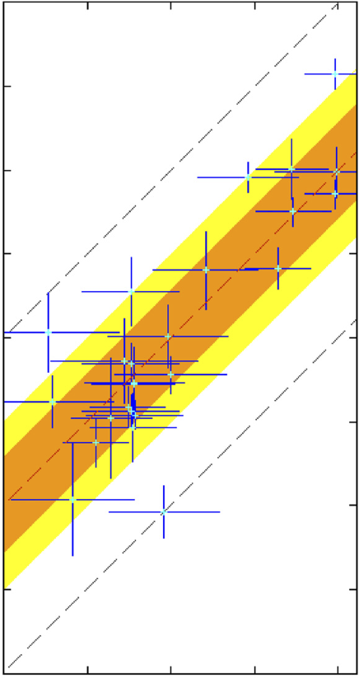
100 pc → 0.1 pc : Consistent B-fields
Ambient 𝜽_{B-field} (deg) (deg)
0º
90º
180º
90º
Core 𝜽_{B-field} (deg)
0º
Li+ 2009
-90º
H.-b. Li+ 2009
Notes:
Orion Molecular Cloud region
-Optical polarimetry data: blue vectors
-Huge grey vectors: average of all blue vectors
-IRAS data: just to guide the eye (background image)
-CSO data: dust emission
-White vectors: average of CSO dust polarization
-ALL orientations are B-field directions
-Comparing with simulations, they find that a super-Alfvénic cloud (more turbulence than magnetic support) doesn’t fit well

Slide 38
Multi-scale comparisons: B-fields
> 1 pc
0.1 pc
1000 AU
100 AU
CONSISTENT
Hua-bai Li+ 2009

Slide 39
Multi-scale comparisons: B-fields
1 pc
0.1 pc
1000 AU
100 AU
(Not always) consistent
Hull+ 2013b
Chapman+ 2013

Slide 40
Cores with consistent large-to-small B-fields
NGC 1333-IRAS 4A
Notes:
Other TADPOL future possibilities:
Intrinsic modeling of B-fields in cores (Fiege)
Constraints on B-fields in protoplanetary disks (Hughes)
Turbulence power spectra (Houde)
Larger scale background-star maps (Mimir, Jameson/Pillai/Clemens)

Slide 41
Cores with consistent large-to-small B-fields
NGC 1333-IRAS 4A
Notes:
Other TADPOL future possibilities:
Intrinsic modeling of B-fields in cores (Fiege)
Constraints on B-fields in protoplanetary disks (Hughes)
Turbulence power spectra (Houde)
Larger scale background-star maps (Mimir, Jameson/Pillai/Clemens)

Slide 42
Cores with consistent large-to-small B-fields
HH 211
Notes:
Other TADPOL future possibilities:
Intrinsic modeling of B-fields in cores (Fiege)
Constraints on B-fields in protoplanetary disks (Hughes)
Turbulence power spectra (Houde)
Larger scale background-star maps (Mimir, Jameson/Pillai/Clemens)

Slide 43
Cores with consistent large-to-small B-fields
HH 211
Notes:
Other TADPOL future possibilities:
Intrinsic modeling of B-fields in cores (Fiege)
Constraints on B-fields in protoplanetary disks (Hughes)
Turbulence power spectra (Houde)
Larger scale background-star maps (Mimir, Jameson/Pillai/Clemens)

Slide 44
Cores with INconsistent large-to-small B-fields
Ser-emb 6
Notes:
Other TADPOL future possibilities:
Intrinsic modeling of B-fields in cores (Fiege)
Constraints on B-fields in protoplanetary disks (Hughes)
Turbulence power spectra (Houde)
Larger scale background-star maps (Mimir, Jameson/Pillai/Clemens)

Slide 45
Cores with INconsistent large-to-small B-fields
Ser-emb 6
See also: Chapman+13
Notes:
Other TADPOL future possibilities:
Intrinsic modeling of B-fields in cores (Fiege)
Constraints on B-fields in protoplanetary disks (Hughes)
Turbulence power spectra (Houde)
Larger scale background-star maps (Mimir, Jameson/Pillai/Clemens)

Slide 46
Cores with INconsistent large-to-small B-fields
L1527
Notes:
Other TADPOL future possibilities:
Intrinsic modeling of B-fields in cores (Fiege)
Constraints on B-fields in protoplanetary disks (Hughes)
Turbulence power spectra (Houde)
Larger scale background-star maps (Mimir, Jameson/Pillai/Clemens)

Slide 47
Cores with INconsistent large-to-small B-fields
L1527
Notes:
Other TADPOL future possibilities:
Intrinsic modeling of B-fields in cores (Fiege)
Constraints on B-fields in protoplanetary disks (Hughes)
Turbulence power spectra (Houde)
Larger scale background-star maps (Mimir, Jameson/Pillai/Clemens)

Slide 48
Cores: B-field consistency
1
0 – 20º
0 – 45º
CDF
ALL CORES
(consistent fields?)
Random
0
0º
𝜽_{small} – 𝜽_{large} (deg)
90º

Slide 49
Alignment vs. polarization fraction
• Core
⨉ Star-forming region
90º
Hull+ 2013b, ApJS, submitted
LO-POL
𝜽_{small} – 𝜽_{large} (deg)
45º
HI-POL
0º
1%
7%
Polarization %

Slide 50
Cores: two populations
HI-POL
(P ≈ 3 – 6%)
LO-POL
(P ≲ 3%)

Slide 51
Polarization “hole” effect
L1157
10%
HIGH %
Polarization %
LOW %
Hull+ 2013b, ApJS, submitted
0%

Slide 52
Cores: two populations
HI-POL
(P ≈ 3 – 6%)
B_{sm} ∥B_{lg}
Outflows random w.r.t. B_{sm}
LO-POL
(P ≲ 3%)
B_{sm} ∦ B_{lg}
Outflows ⟂ B_{sm}

Slide 53
Multi-scale comparisons: B-fields vs. outflows
1 pc
0.1 pc
1000 AU
100 AU
Back to outflows!
RANDOM
Hull+ 2013a

Slide 54
Multi-scale comparisons: B-fields vs. outflows
1 pc
0.1 pc
1000 AU
100 AU
RANDOM
Or preferentially ⟂ ?
Hull+ 2013a

Slide 55
Multi-scale comparisons: B-fields vs. outflows
1 pc
0.1 pc
1000 AU
100 AU
Random (HI-POL)
⟂ (LO-POL)

Slide 56
Cores: B-field vs. outflow alignment
1
0 – 20º
0 – 45º
CDF
Random
ALL CORES
(random/misaligned?)
70 – 90º
0
0º
𝜽_{outflow} – 𝜽_{B-field} (deg)
90º
Notes:
hi_pol = [ 'IRAS4A', 'HH211', 'L1157', 'MMS5', 'MMS6', 'CB230', 'SerEmb8', 'SerEmb8N' ]
lo_pol = [ 'CB26', 'CB54', 'IRAS2A', 'IRAS4B2', 'IRAS4B', 'L1448I', 'L1448N', 'L1455', 'L1527', 'L1551', 'VLA1623' ]

Slide 57
Cores: B-field vs. outflow alignment
1
0 – 20º
0 – 45º
CDF
Random
HI-POL
(random)
70 – 90º
0
Hull+ 2013b, ApJS, submitted
0º
𝜽_{outflow} – 𝜽_{B-field} (deg)
90º

Slide 58
Cores: B-field vs. outflow alignment
1
0 – 20º
0 – 45º
CDF
Random
70 – 90º
LO-POL
(misaligned)
0
Hull+ 2013b, ApJS, submitted
0º
𝜽_{outflow} – 𝜽_{B-field} (deg)
90º

Slide 59
HI-POL: B-fields random w.r.t. outflows
IRAS 4A
HH 211
Ser-emb 8
B-field
Outflow
OMC3-MMS6
Notes:
Other TADPOL future possibilities:
Intrinsic modeling of B-fields in cores (Fiege)
Constraints on B-fields in protoplanetary disks (Hughes)
Turbulence power spectra (Houde)
Larger scale background-star maps (Mimir, Jameson/Pillai/Clemens)

Slide 60
LO-POL: B-fields ⟂ outflows
VLA 1623
L1527
IRAS 4B
B-field
Outflow
L1551 NE
Notes:
Other TADPOL future possibilities:
Intrinsic modeling of B-fields in cores (Fiege)
Constraints on B-fields in protoplanetary disks (Hughes)
Turbulence power spectra (Houde)
Larger scale background-star maps (Mimir, Jameson/Pillai/Clemens)

Slide 61
HI-POL vs. LO-POL
IRAS 4A
Consistent B-fields
HI-POL
U_{B} > U_{dyn}
B-fields can resist twisting
from dynamic effects
Less line-of-sight twisting = higher polarization fraction
Consistent large-to-small-scale B-fields

Slide 62
HI-POL vs. LO-POL
IRAS 4A
HI-POL
U_{B} > U_{dyn}
B-fields can resist twisting
from dynamic effects
Less line-of-sight twisting = higher polarization fraction
Consistent large-to-small-scale B-fields
B-fields still are not correlated with outflows
Angular momentum direction unaffected by “global field”

Slide 63
HI-POL vs. LO-POL
L1527
LO-POL
U_{B} < U_{dyn}
More line-of-sight twisting = lower polarization fraction
Inconsistent large-to-small-scale B-fields
INConsistent B-fields

Slide 64
HI-POL vs. LO-POL
L1527
LO-POL
U_{B} < U_{dyn}
B-fields are twisted by rotation
More line-of-sight twisting = lower polarization fraction
Inconsistent large-to-small-scale B-fields
B-fields are ⟂ to outflows
No longer looking at global field
This could aid in disk formation

Slide 65
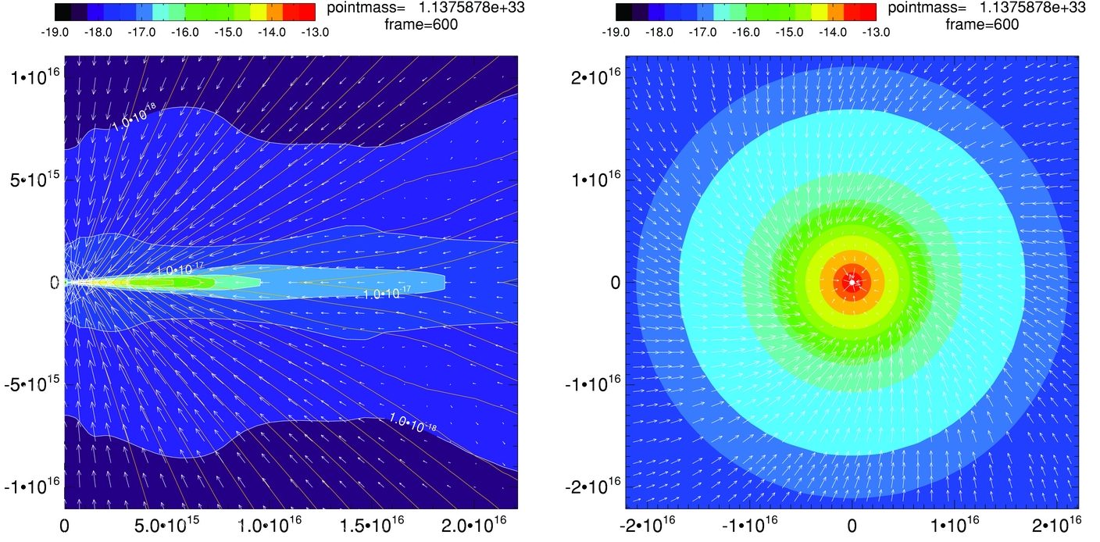
Magnetic braking catastrophe
Not rotationally supported!
Z.-Y. Li+2011

Slide 66
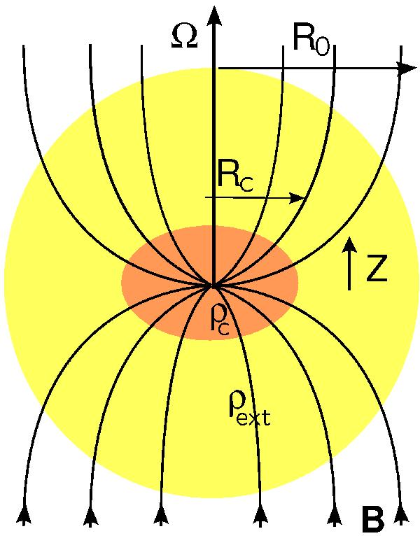
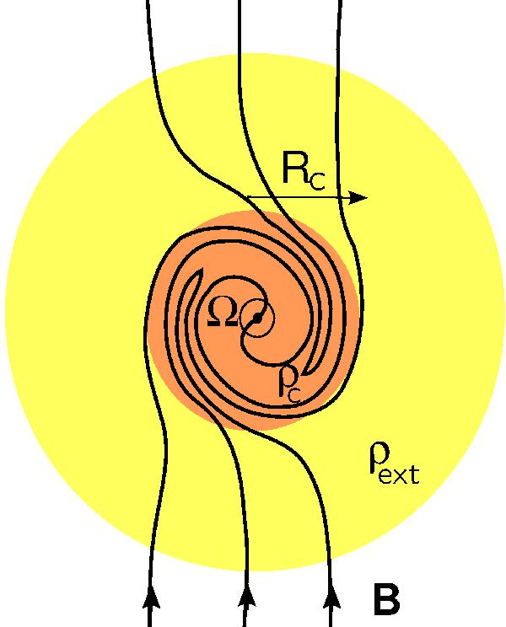
Magnetic braking catastrophe
Joos+2012
ALIGNED B-field & rotation
MORE magnetic braking
MISALIGNED B-field & rotation
LESS magnetic braking

Slide 67
LO-POL: B-fields ⟂ outflows
VLA 1623
L1527
IRAS 4B
B-field
Outflow
L1551 NE
Notes:
Other TADPOL future possibilities:
Intrinsic modeling of B-fields in cores (Fiege)
Constraints on B-fields in protoplanetary disks (Hughes)
Turbulence power spectra (Houde)
Larger scale background-star maps (Mimir, Jameson/Pillai/Clemens)

Slide 68
HI-POL vs. LO-POL: open questions
HI-POL
Are they younger?
Or have stronger B-fields?
Is our view is just dominated by the global field?
If so, are the fields actually twisted at smaller scales?
LO-POL
Are they older?
Or have weaker B-fields?
Are the twisted B-fields we see at 1000 AU consistent with B-fields at disk scales?

Slide 69
FUTURE multi-scale comparison: B-fields
?
1 pc
0.1 pc
1000 AU
100 AU
Machida+ 2006
180 AU
CARMA/SMA +
ALMA

Slide 70
Outline
Magnetized star formation
B-fields vs. outflows: multi-scale comparisons
Outflows/jets/disks and B-fields are randomly aligned (or perhaps ⟂?)
TADPOL survey
CARMA 1mm full-Stokes polarization system
B-fields: multi-scale comparisons
Cloud → core → envelope → disk
Two populations of cores: high and low polarization fraction
Back to outflows!
Disk formation implications
VLA proposal
Filaments in the Perseus cluster (NGC 1275)

Slide 71
Filaments in the Perseus cluster (NGC 1275)
10⁸ K gas
Fabian+ 2008
H-alpha filaments around 3C84
(10⁴ K gas)

Slide 72

Filaments in the Perseus cluster (NGC 1275)
10⁸ K gas
PI: James McBride
Fabian+ 2008

Slide 73
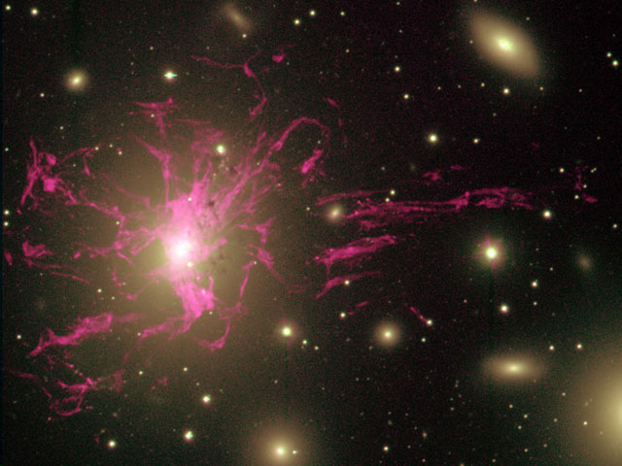
Filaments in the Perseus cluster (NGC 1275)
Conselice+ 2001
Notes:
-Optical: Halpha, indicating "cool" (~1e4 K) gas.
-X-ray: entire region is filled with hot (~1e8 K) gas
-Filaments’ existence suggests that they are threaded by strong B-fields that prevent conduction from heating the filaments on timescales of ~century.
-We proposing to confirm that by observing synchrotron, first in total intensity, and then in polarized emission.
-Observations will yield insights on physics of the ICM, particularly energy transport.
-Are electrons trapped along magnetic field lines able to travel significant distances within the cluster?
-Understanding energy transport is important because untested assumptions about electron conduction underlie attempts to measure galaxy cluster masses using observations of x-ray bremstrahllung.
-Galaxy cluster masses are, in turn, used to constrain cosmological parameters.
-The filaments are part of the cycle of heating/cooling gas that is critical to understanding feedback and galaxy formation.
-Ideas about filament formation include directly cooling gas from the 10^8 K surroundings, or entrainment of buoyant bubbles driven in the ICM by radio jets from AGN.

Slide 74
Summary (1/4)
B-fields are randomly aligned with respect to outflows at the ~1000 AU scale
Thus, circumstellar disks are misaligned with fields in the cores from which they formed
CDF
𝜽_{outflow} – 𝜽_{B-field} (deg)
0º
90º
Notes:
Other TADPOL future possibilities:
Intrinsic modeling of B-fields in cores (Fiege)
Constraints on B-fields in protoplanetary disks (Hughes)
Turbulence power spectra (Houde)
Larger scale background-star maps (Mimir, Jameson/Pillai/Clemens)

Slide 75
Summary (2/4)
HI-POL sources
Consistent large- to small-scale B-fields
Outflows and B-fields are randomly aligned
Global field doesn’t affect final angular momentum
Notes:
Other TADPOL future possibilities:
Intrinsic modeling of B-fields in cores (Fiege)
Constraints on B-fields in protoplanetary disks (Hughes)
Turbulence power spectra (Houde)
Larger scale background-star maps (Mimir, Jameson/Pillai/Clemens)

Slide 76
Summary (3/4)
LO-POL sources
INconsistent large- to small-scale B-fields
Outflows and B-fields are perpendicular
Fields may be wrapped up by envelope rotation
Notes:
Other TADPOL future possibilities:
Intrinsic modeling of B-fields in cores (Fiege)
Constraints on B-fields in protoplanetary disks (Hughes)
Turbulence power spectra (Houde)
Larger scale background-star maps (Mimir, Jameson/Pillai/Clemens)

Slide 77
Summary (4/4)
Questions:
Why are B-fields and outflows randomly aligned?
What will disk-scale B-field measurements show?
TADPOL data release: arXiv:1310.6653
TADPOL outflows vs. B-fields: ApJ, 768, 159
TADPOL survey: tadpol.astro.illinois.edu
Notes:
Other TADPOL future possibilities:
Intrinsic modeling of B-fields in cores (Fiege)
Constraints on B-fields in protoplanetary disks (Hughes)
Turbulence power spectra (Houde)
Larger scale background-star maps (Mimir, Jameson/Pillai/Clemens)

Slide 78
Summary
(2) HI-POL: consistent B-fields, random outflows
(1) Random outflows vs. B-fields
(3) LO-POL: B-fields wrapped by rotation
TADPOL data release
arXiv:1310.6653
TADPOL outflows vs. B-fields
ApJ, 768, 159
TADPOL survey
tadpol.astro.illinois.edu
Notes:
Other TADPOL future possibilities:
Intrinsic modeling of B-fields in cores (Fiege)
Constraints on B-fields in protoplanetary disks (Hughes)
Turbulence power spectra (Houde)
Larger scale background-star maps (Mimir, Jameson/Pillai/Clemens)

Slide 79
Fin

